Slide 1
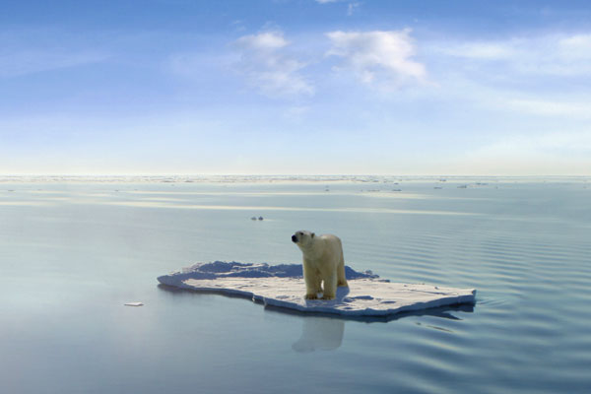
Causes of biodiversity loss:
Climate change

Slide 2
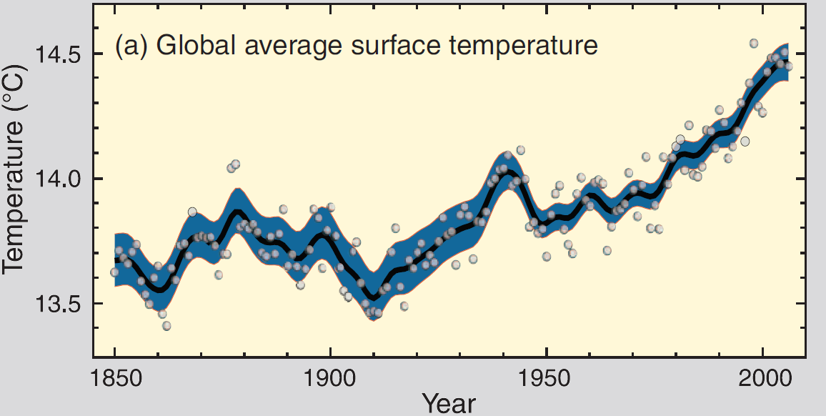
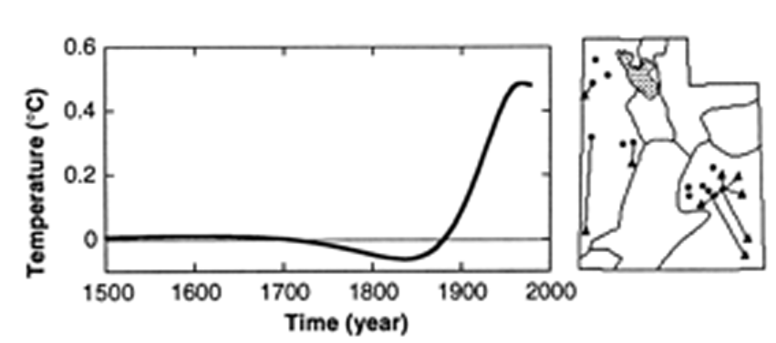
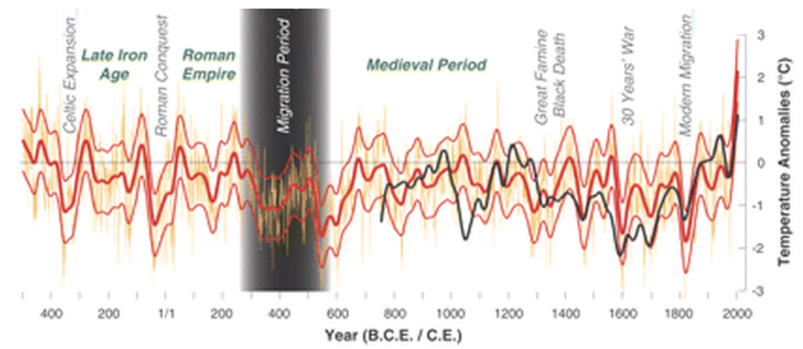
So what is happening?
Temperature is increasing
Utha (Harris & Chapman, Science 2009)
Europe (Büntgen et al., Science 2011)

Slide 3
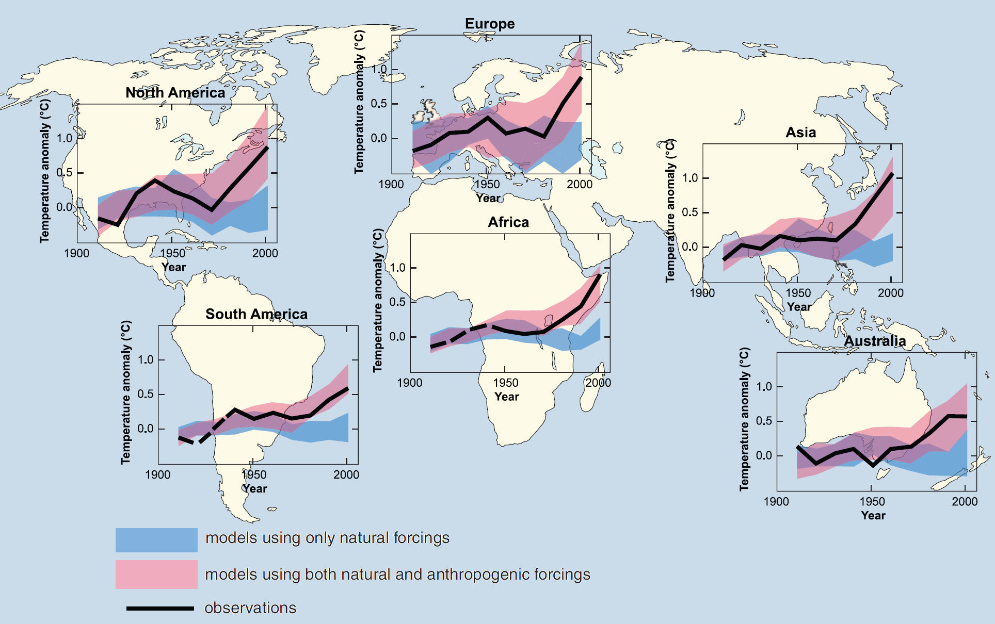
…and it happening everywhere…

Slide 4
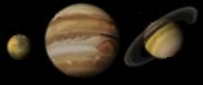
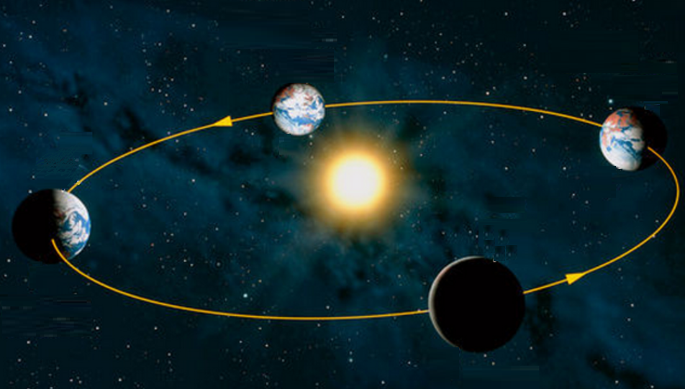
The Earth’s climate
Milankovitch cycles
Saturn
ICE AGES
Jupiter
22.1º and 24.5º every 41,000-year
Tilt: 23.4º
0 and 0.05 every 26,000 years
0.005 and 0.058 every 413,000 years
SEASONS
Axial precession: 0.01
Eccentricity: 0.017
Hays et al. “Variations in the Earth's Orbit: Pacemaker of the Ice Ages”. Science (1976)

Slide 5
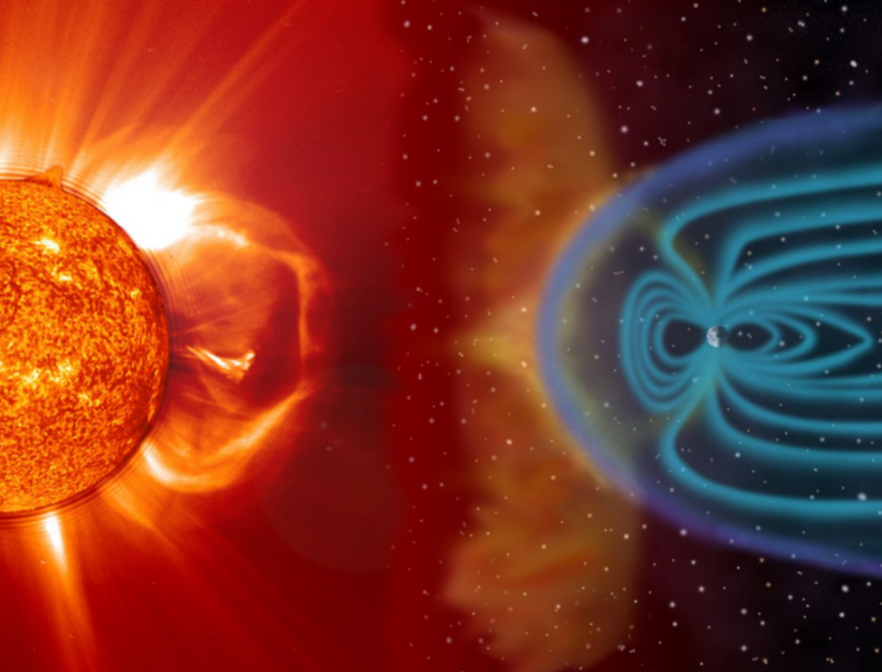
The Earth’s climate
Solar flares
Flares occur almost every day but large flares very rarely; the last one in 1859
Radiation six times larger than normal
Explosion
At the speed of light, it takes ~ 8 minutes to get to Earth
Earth’s
electromagnetic
shield
Notes:
There is the Earths electromagenetic shield, generate by the Earth internal core, which diverts the flares. Flare occur almost every day but large flares ocurr very rarely, the last one in 1859

Slide 6
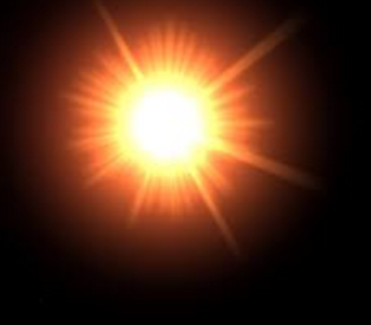
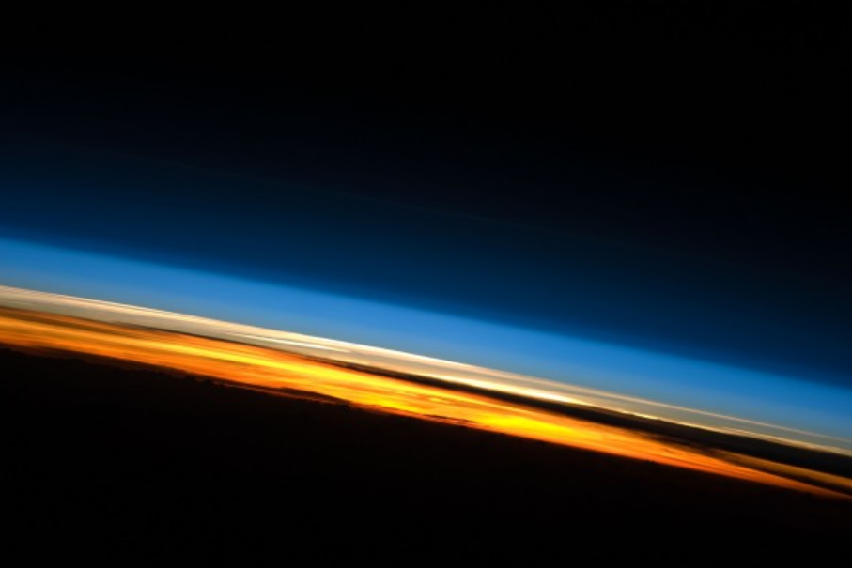
The Earth’s climate
Sunlight and green house effect
Extreme UV 10-120 nm (nanometres)
ATMOSPHERE:
Thermosphere
Mesosphere
NATURAL
Water vapor
Carbon dioxide
Methane
Nitrous oxide
Ozone
Far to near UV 120-400 nm
Stratosphere
Visible and InfraRed (IR)
MAN GENERATED
Carbon dioxide (CO2)
Methane (CH4)
Nitrous oxide (N2O)
Halocarbons
X-Rays
Radiative forcing
Radiates infrared heat in the range 4–100 μm
INCREASE
TEMPERATURE
Notes:
The Earth receives energy from the Sun in the form UV, visible, and near IR radiation, most of which passes through the atmosphere without being absorbed. Of the total amount of energy available at the top of the atmosphere (TOA), about 50% is absorbed at the Earth's surface. Because it is warm, the surface radiates far IR thermal radiation that consists of wavelengths that are predominantly much longer than the wavelengths that were absorbed. Most of this thermal radiation is absorbed by the atmosphere and re-radiated both upwards and downwards; that radiated downwards is absorbed by the Earth's surface.

Slide 7
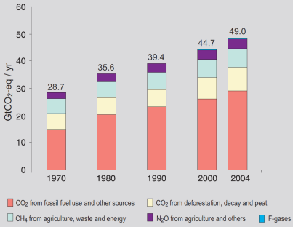
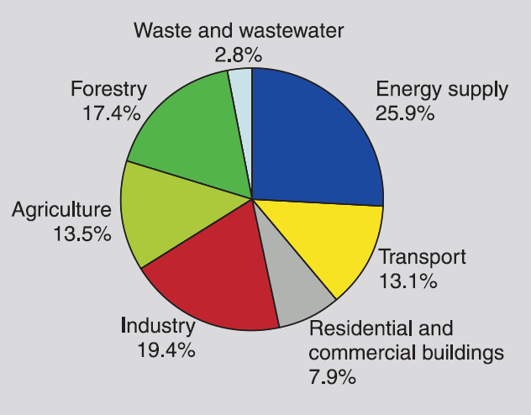
Can we make a connection with humans?
IPCC 2011 report

Slide 8
…models confirm the role of anthropogenic forces on climate warming…

Slide 9
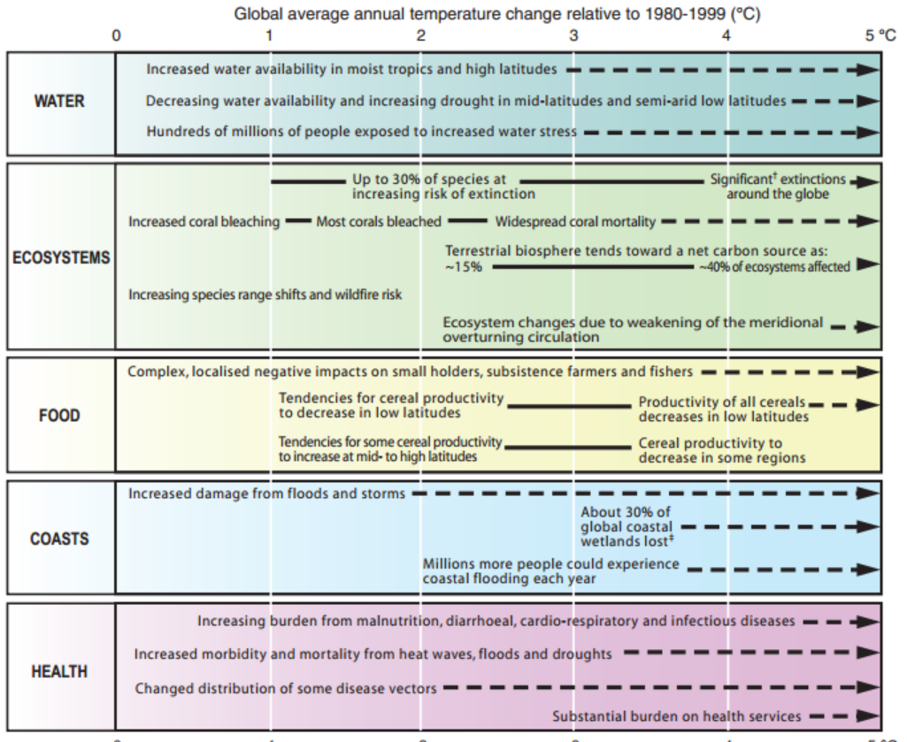
So what if it is truly getting warmer?
IPCC 2011 report

Slide 10
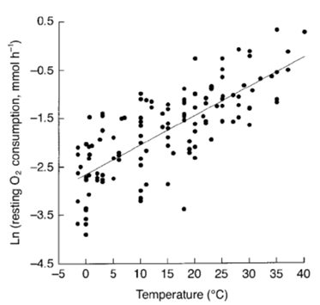
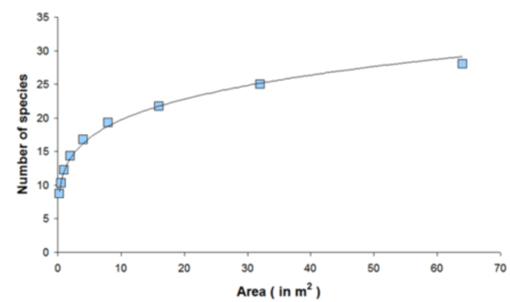
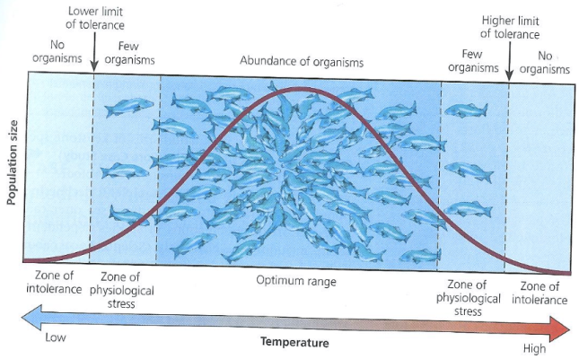
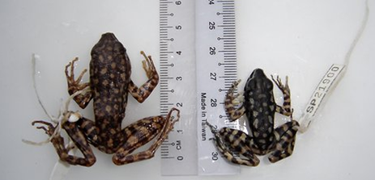
Consequences on Biodiversity
Biodiversity
Temperature
Acidification
Climate Change
Body
size
Species
richness
Abundance
Suitable habitat lost due to warming will ‘commit’ 15–37% of bird species to extinction (Thomas et al. Nature 2003)
Clarke & Jonhston, J. Ani.Ecol. 1999
20-40% of the Earth’s species are likely to go extinct (Parmesan and Yohe Nature 2003)
1980s
2008
>80% of the world’s coral reefs (Donner BioScience 2009)
>41% of the tropical reef fishes vulnerable via the loss of coral reefs (Graham et al. Ecology Letters 2011)
2ºC ↑= Body size 3-22%↓
Sheridan & Bickford, Nature Climate Change 2011
↑ Vulnerability

Slide 11
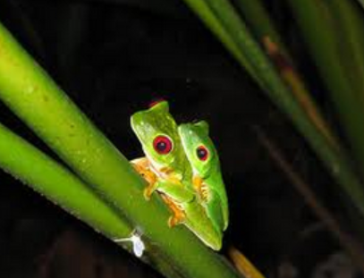
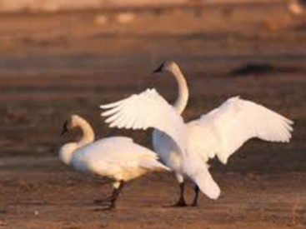
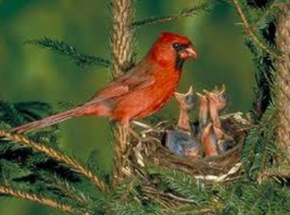
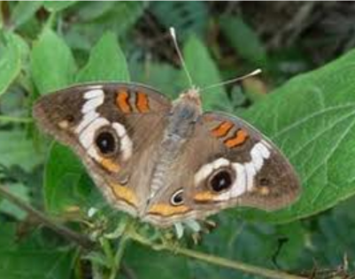

Additional ecological consequences of climate change
Phenological shifts
(Parmesan & Yohe, Nature 2003)
Earlier frog breeding
Earlier arrival of migrant birds
Out of 677 species reported in the literature, 27% showed no trends in phenologies, 9% showed trends towards delayed spring events, and 62% showed trends towards spring advancement.
Earlier bird nesting
Earlier arrival of migrant butterflies
Earlier ﬁrst ﬂowering
Desynchronize food and habitat availability, reproductive cicles
Increase risk of mortality

Slide 12

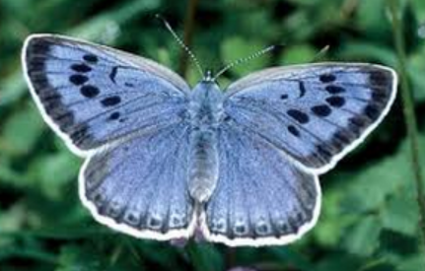
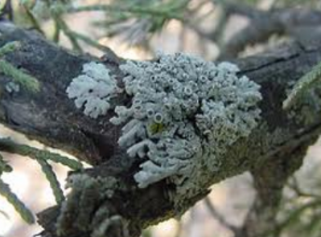
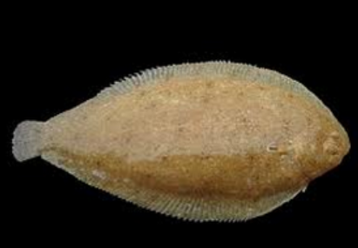
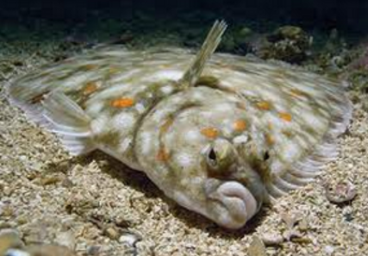
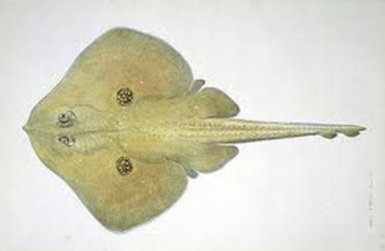
Additional ecological consequences of climate change
Poleward shifts
Distribution/abundance shifts
Anemones in Monterey
Butterflies in Europe
Range shifts averaging 6.1 km per decade towards the poles (Parmesan & Yohe, Nature 2003)
Over the past 40 years, maximum range shifts vary from 200 km (butterﬂies) to 1,000 km (marine copepods)
(Parmesan & Yohe, Nature 2003)
Lichens in Netherlands
Fishes in the north Atlantic
Shifts ranged from 48 to 403 km
Perry et al., Science 2005
Local extinctions and invasions changing species composition by >60% (Cheung et al. Fish & Fish 2009)
21 out of 36 analyzed species are also moving deeper
Perry et al., Science 2005
High risk of impairing functionality of ecosystems and delivery services (Cheung et al. Fish & Fish 2009)

Slide 13
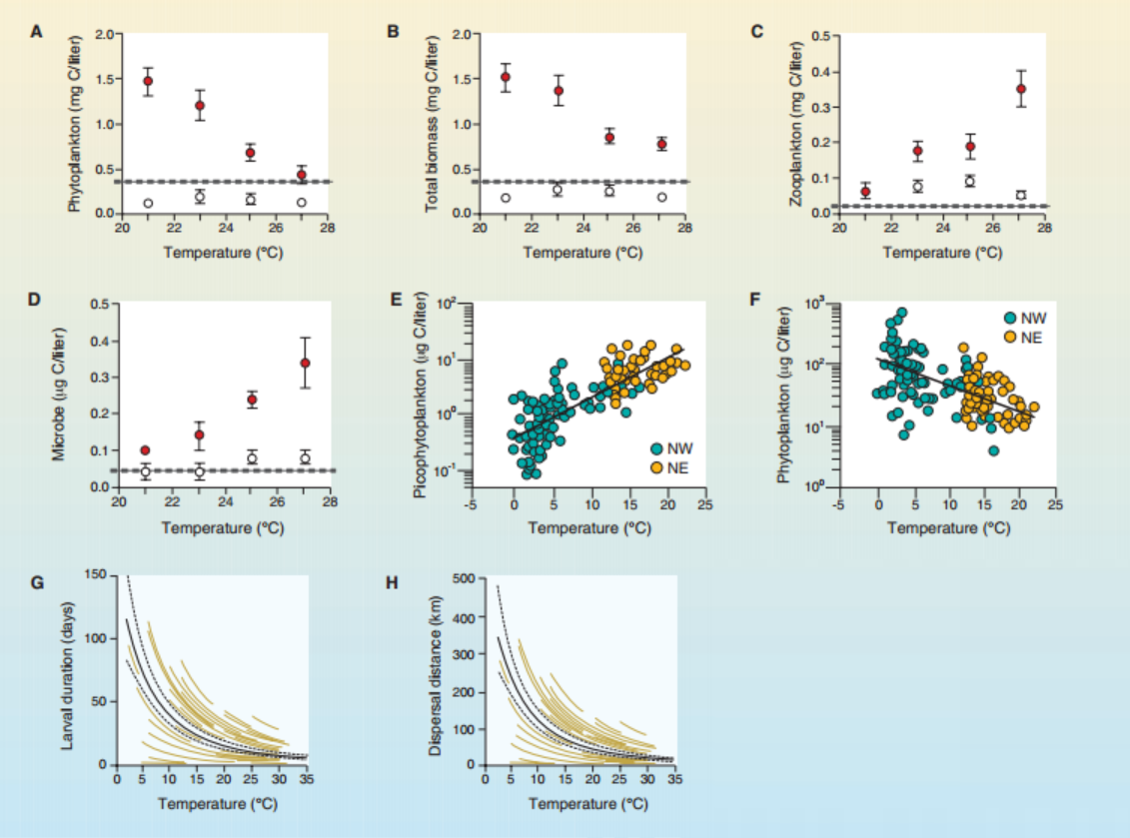
Consequences of climate change on the ocean
Hoegh-Guldberg & Bruno., Science 2010

Slide 14
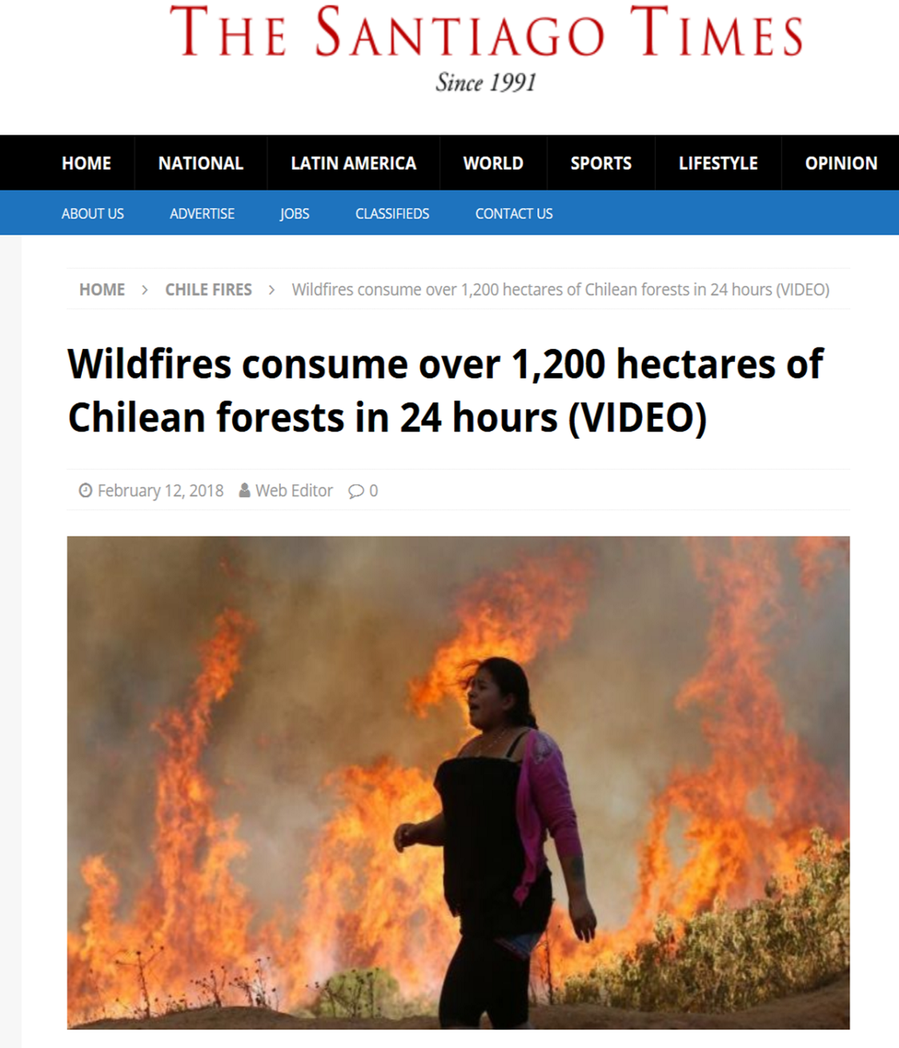
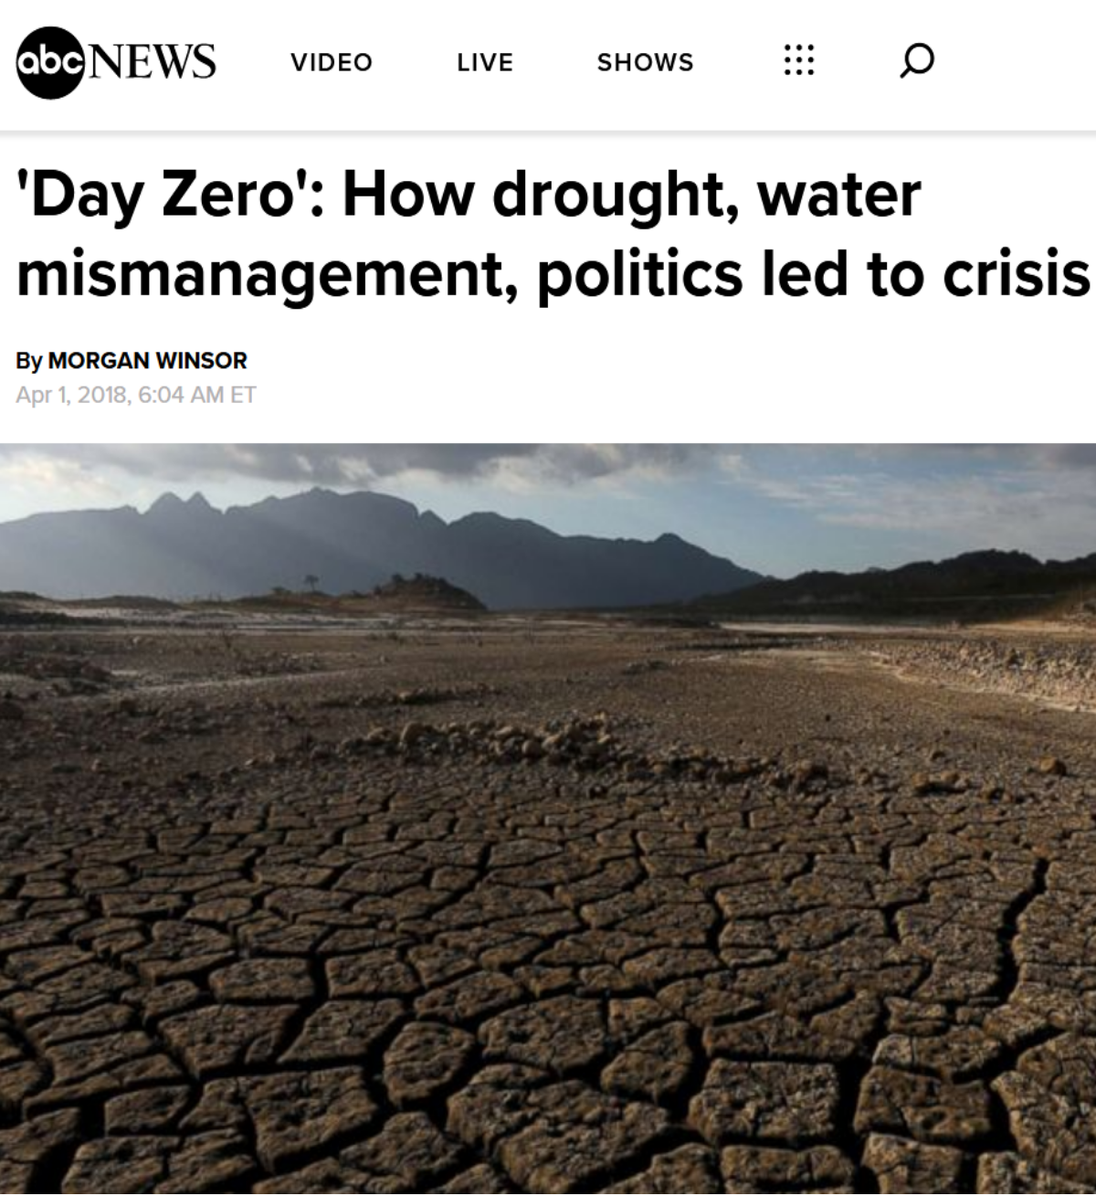
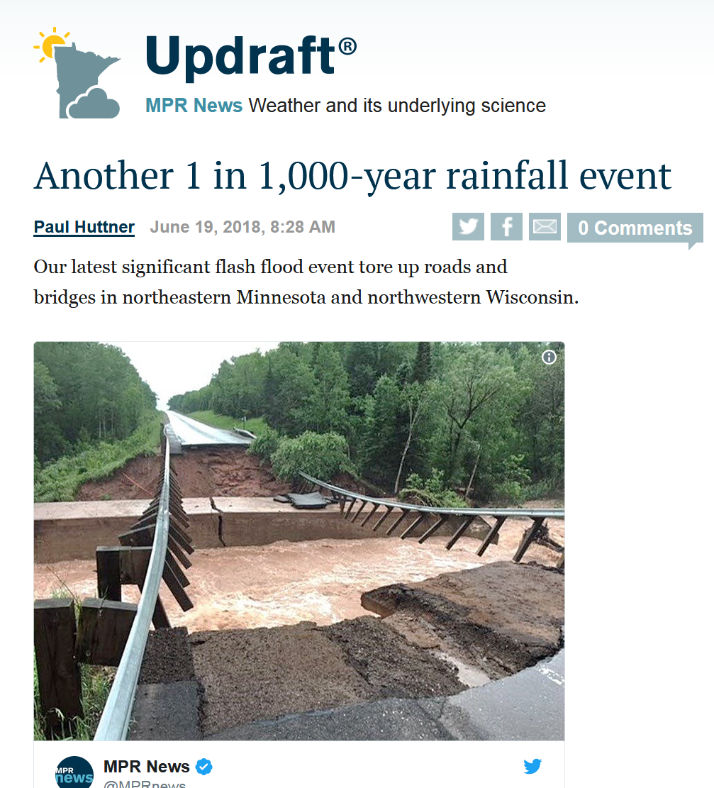
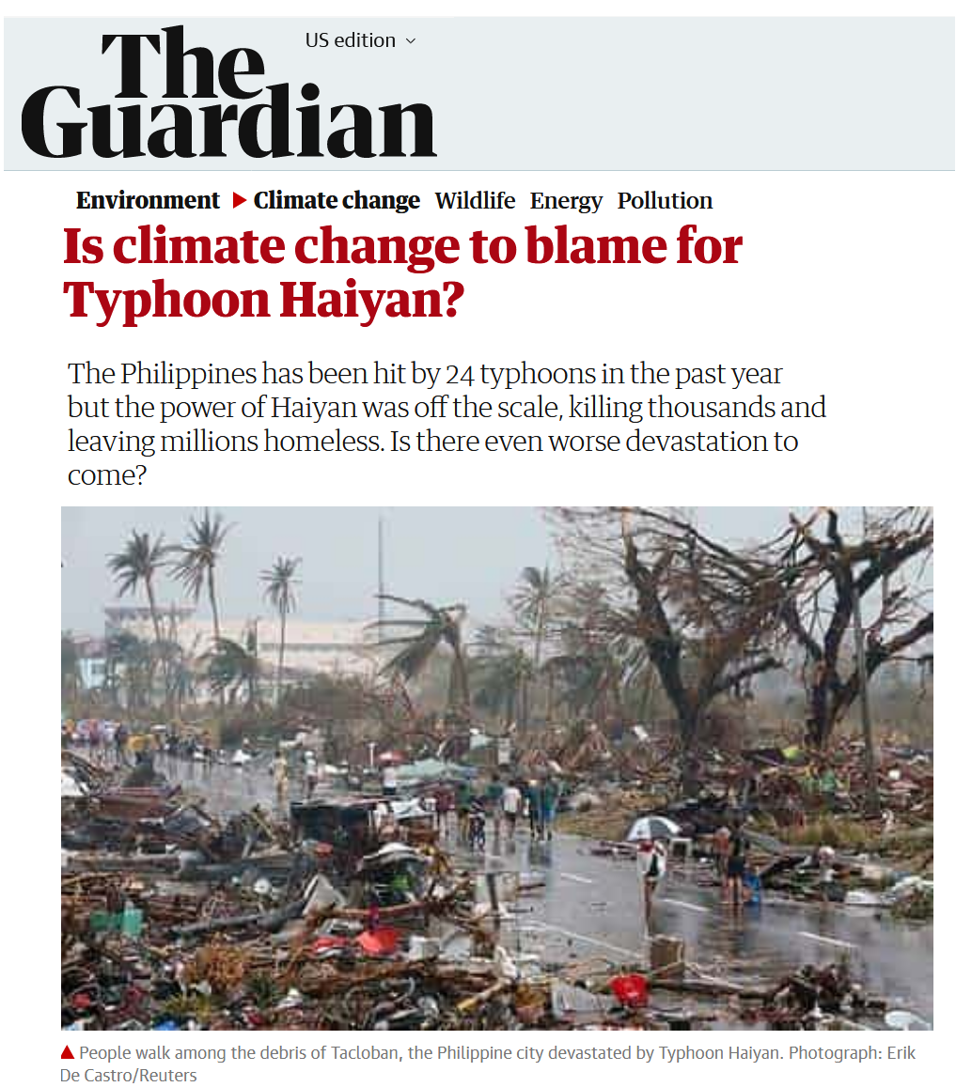
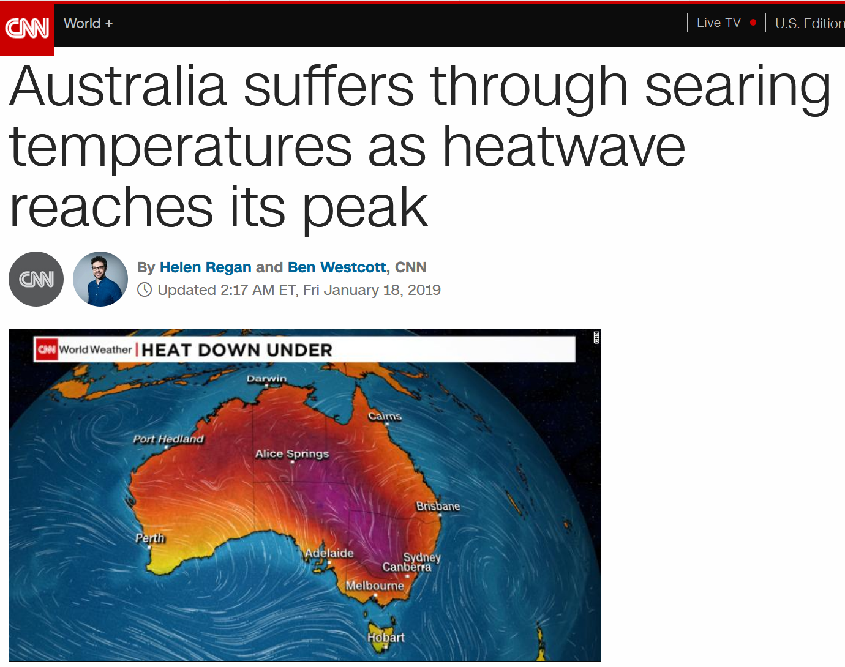
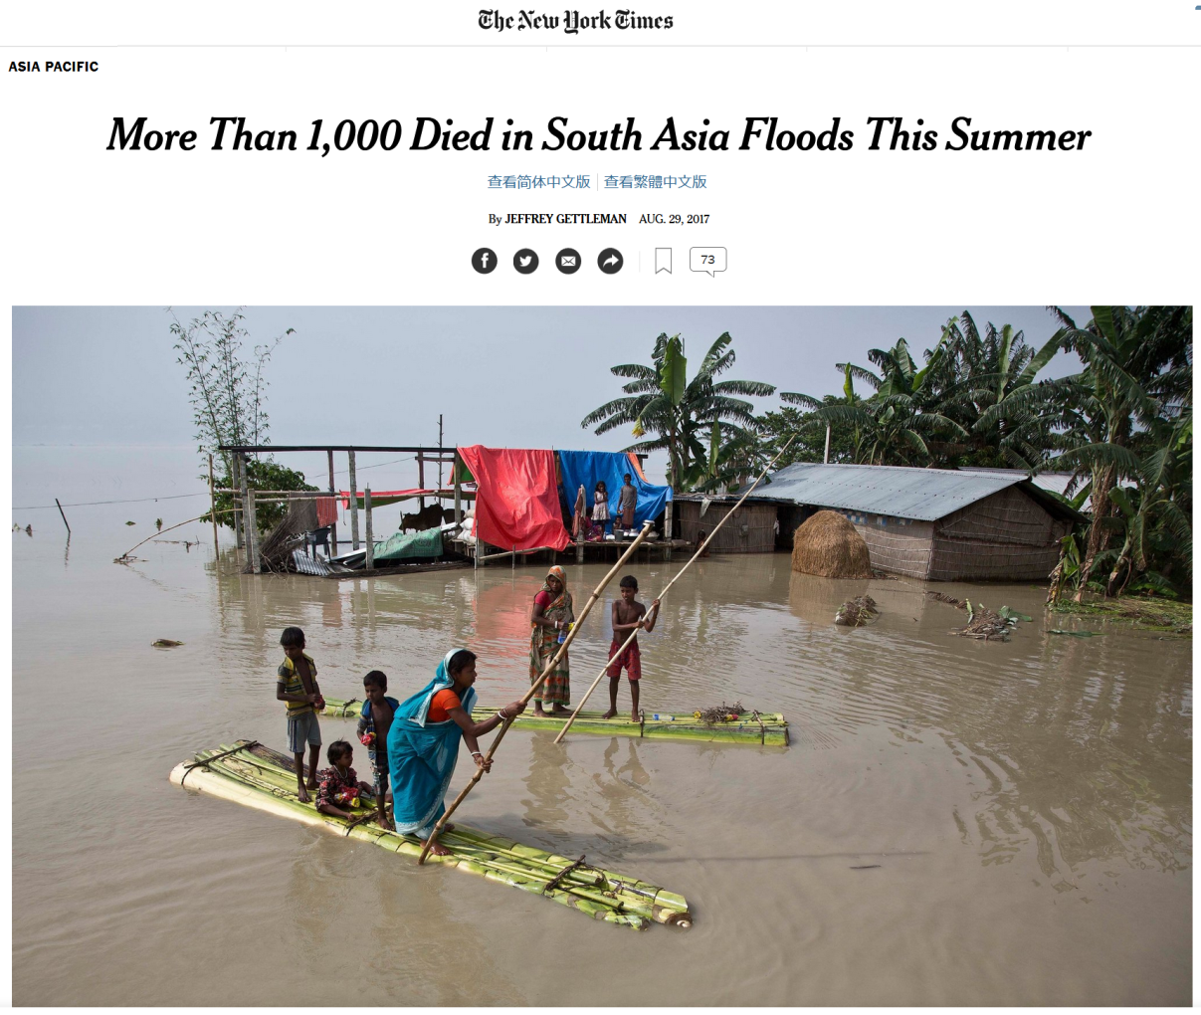






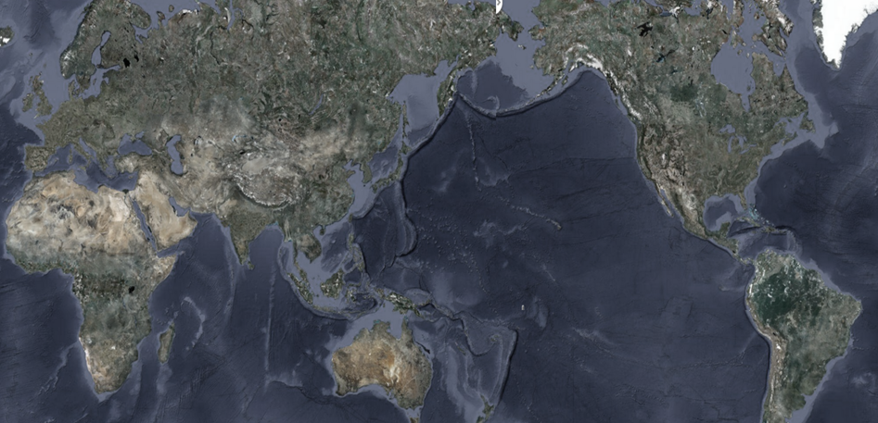




What about impacts on people?
Australia, 2019
Chile, 2018
South Africa, 2018
Minnesota and Wisconsin, 2018
South Asia, 2017
Haiyan, Philippines 2016
Drought
Heatwaves
Wildfires
Rain
Floods
Storms

Slide 15
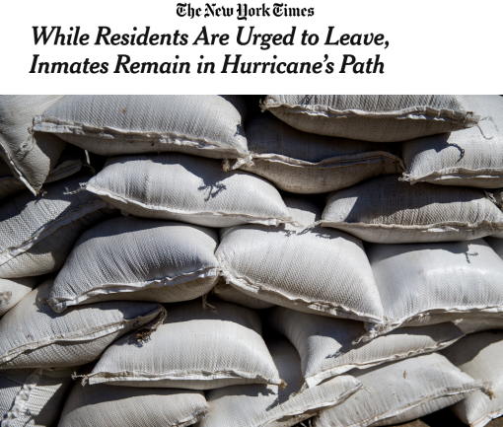
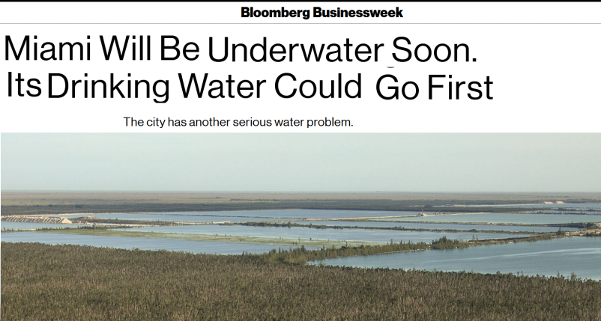
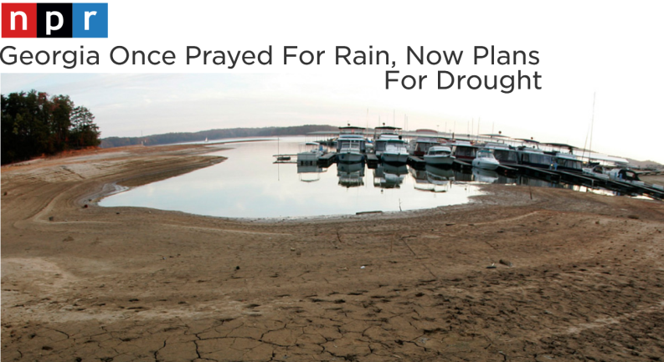
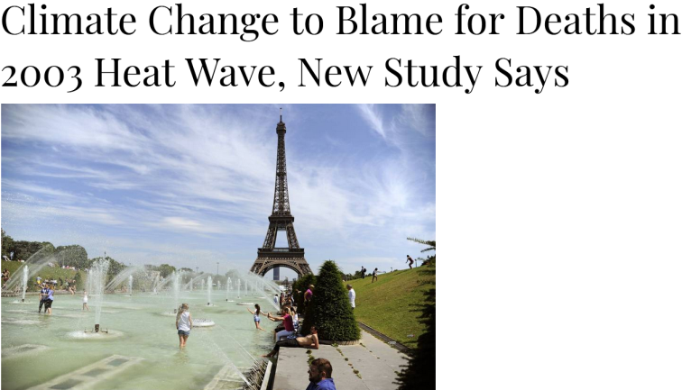
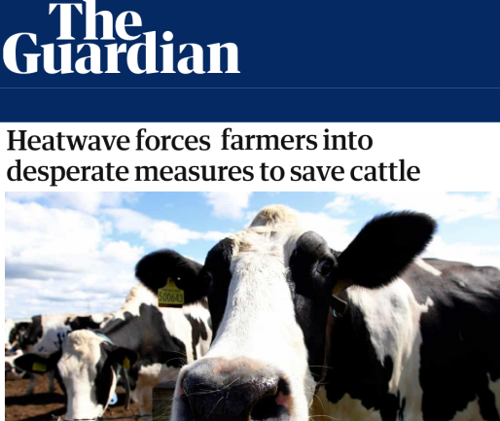
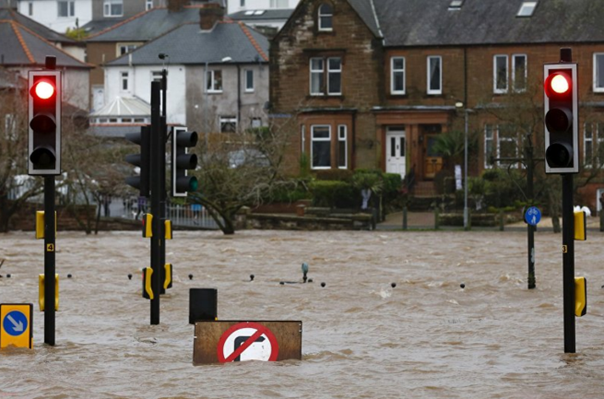
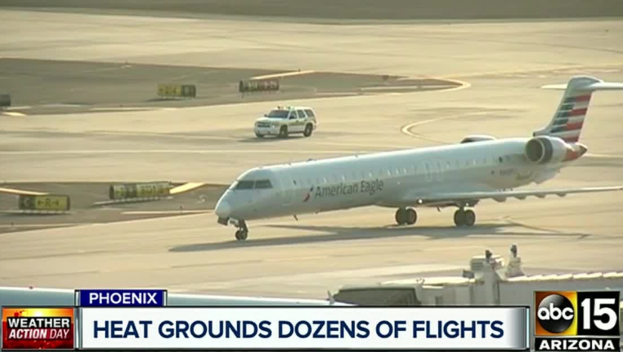
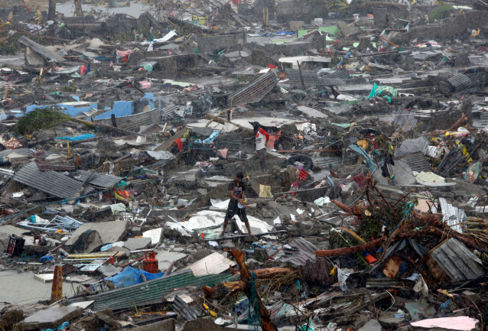
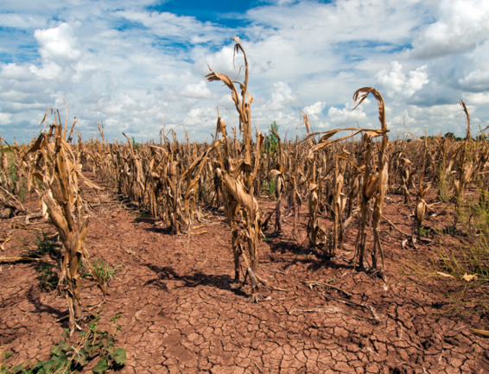
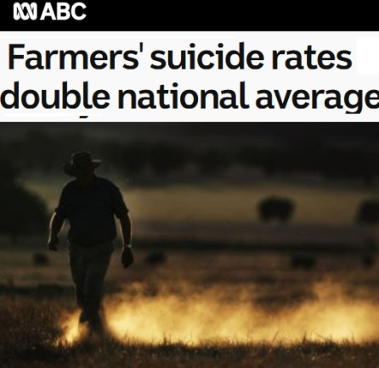




Davies (2013): …[a US heatwave in 2013]…18 … flights from Phoenix were cancelled… after temperatures hit 119 degrees."..."heat reduces air density …increasing power needed to lift up the plane”.
…so what?...
Gouvea et al. (2013):..in 2007, drought in Atlanta, Georgia, reduced hydropower generation by 51%.
Frumhoff (2007): …in several of the East’s coastal areas [USA], excessive groundwater pumping exacerbated by rising sea levels has produced saltwater intrusion problems.
Busby and Loy (1996): …a heat wave in July, 1995, caused the loss of approximately 3750 head of cattle in western Iowa...
Association of British Insurers (2002): …Following the October-November 2000 floods in England and Wales, the Association of British Insurers negotiated … to withdraw flood insurance from locations at greatest risk.
Berry et al. (2008): The recent drought in the south-east [Australia] was the worst in a century…the stresses of lost income, debt and damage to [crops] have spilled over into mental health problems for some [farmers] and to the tragedy of despair and suicide for a few.
Patz et al. (2005):…. approximately 22,000 to 45,000 heat-related deaths [heatwave] occurring across Europe over two weeks in August 2003…
Marcus (2017): …after Hurricane Katrina, …eight thousand people, mostly indigent and charged with misdemeanors such as public drunkenness or failure to pay traffic tickets, languished indefinitely in state prisons. The court system shut its doors, the police department fell into disarray….
Epstein (2001): In the aftermath [of hurricane Mitch], Honduras reported 30,000 cases of cholera, 30,000 cases of malaria and 1,000 cases of dengue fever.
Travasso et al. (2003):…anomalies in SouthAtlantic sea-surface temperatures (SST) were significantly related to crop-yield variations in the Pampas region of Argentina.
De Sherbinin et al. (2011): In 1998 Hurricane Mitch, the most deadly Atlantic storm in more than 200 years, killed more than 11,000 people in Honduras and Nicaragua.
Natural land cover Δ
…impact was broadly considered as any case example of “an explicit climate hazard causing a response on an explicit aspect of human life in an explicit or implicit place and time”…..
Ocean chemistry Δ
↑Sea level
Addiction
Vector-borne disease
Famines
Toxic exposure
Malnutrition
↑Storms
Health
Culture
Disease
Food poisoning
Mental health
PTSD
27
Risk of accidents
Depression
Affective disorder
Sick
Air quality hazard
Pathogen diseases
Educational attainment
↑Floods
Zoonotic envenoming
Suicide
Children's health
Recreation
Prenatal health
Life expectancy
Stress
Solastalgia
Life satisfaction
Injuries
Death
↑Precipitation
Food
Agriculture
Hunting
Marine fisheries
10
Contamination
Nutrition value
Aquaculture
Hungry
↑Wildfires
Livestock
Food prices
Food shortages
Water
↑Heatwaves
Scarcity
5
Thirsty
Supply
Quality
↑Drought
Run-off and flow
Economy
Tourism
Infrastructure damage cost
Prices
Insurance
Relief effort costs
16
Adaptation costs
Natural resources
Income
Poor
↑Temperature
Jobs
Economic growth
Economic loss
Land value
Labor productivity
Property damage costs
Health care costs
Operation costs
Shelter
Irrigation
Dams
Levee
Navegation
Air transport
Transport
GREENHOUSE GASSES
Infrastructure
Landslides
Roads
Bridge
21
Electricity
Communications
Homeless
Multiple critical infrastructure
Buildings
Coastal barrier
Land loss
Railroad
Health infrastructure
Energy infrastructure
Water and waste water
Ports
Security
Conflict
Displacement
Evacuation
Military buildup
11
Democracy
Gender inequality
Aggressive behaviour
Unsafe
Social order
Criminal behaviour
Violence
Migration
Mora et al. Nature Climate Change (2018)
Notes:
Natural land cover change is included as the increase in greenhouse gases is not only a product of fossil fuels but the destruction of the natural world, which can not only add more greenhouse gases but reduce the amount of gases that can be sequestered.
12,000 papers scrutinized for impacts

Slide 16
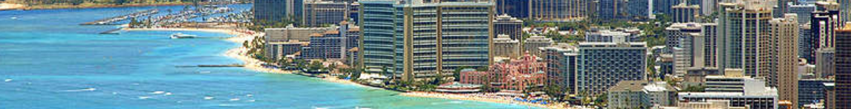

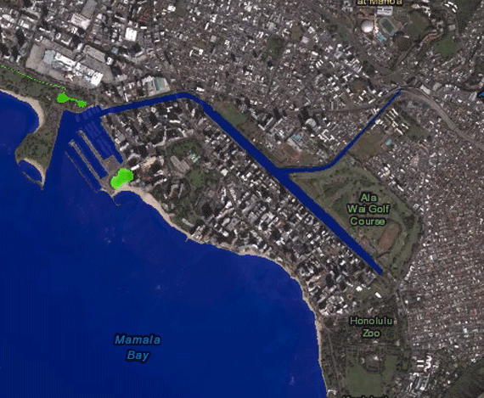


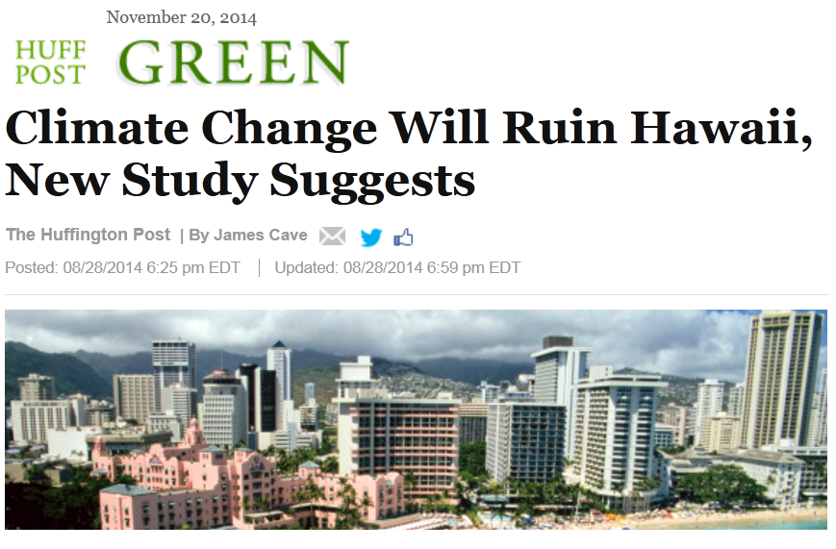




What about
climate change in Hawaii?
Air warming of 0.3ºF (0.17 ºC) per decade, up to 7ºF by 2100
Sea warming of 0.41ºF (0.23 ºC) per decade, up to 2.7 ºC by 2100
Sea level rise up to 1.3in(3.3cm), up to
3 ft by 2100
Food
Increased drought in some places and excessive rain in others
Housing
Jobs
Health
Decrease precipitation, reduction of stream flow and aquifer recharge
Water
New shoreline would be ~ 1 full mile inland
$2 billion lost overall, each year
Ocean acidification increase of 30%, threatening corals and shelf-organisms
Human health increase vector-borne diseases- dengue fever, flu
Climate Change Impacts in Hawai‘i -A summary of climate change and its impacts to Hawai‘i’s ecosystems and communities (2014)UNIHI-SEAGRANT-TT-12-0

Slide 17
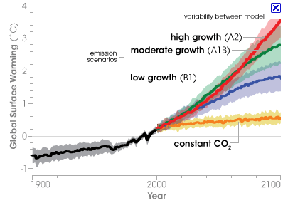

And what is the future?

Slide 18
…in summary…
Increase in CO2 and other greenhouse gases…
…causes atmospheric warming…
…messes with climatic variables
…messes with species and people
…as for impact to biodiversity, this is
a game changer…

